Slide 1
Telescopes
Year 7 Science

Slide 2
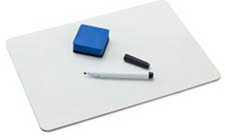
Review
Draw the Earth, showing the axis tilt, the equator, the tropic of Cancer and Capricorn and the Arctic and Antarctic circle. | Show the position of the Sun, Earth and moon during a full moon.
Show the position of the Sun, the Earth and the moon during a new moon. | Show the position of the Sun, the Earth and the moon during a solar eclipse.

Slide 3
Learning Intentions
Predictable phenomena on Earth, including seasons and eclipses, are caused by the relative positions of the Sun, Earth and the Moon.

Slide 4
Success criteria
Explain how telescopes work.
List three different types of telescopes.

Slide 5


Slide 6
Success criteria
Explain how telescopes work.
List three different types of telescopes.

